Slide 1
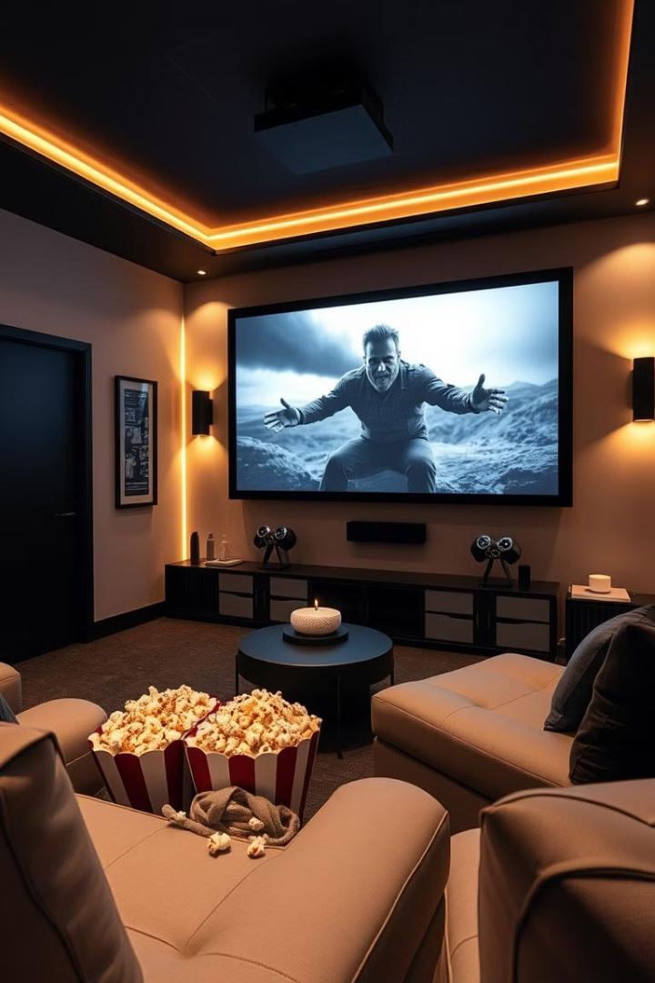
Movie Recommendation Systems: A Hybrid Approach
Movie Recommendation Systems (MRS) are vital in the entertainment industry. They guide users through vast movie libraries.
This presentation explores a hybrid approach combining content-based and collaborative filtering, designed to enhance personalization and accuracy in movie recommendations.

Slide 2
The Need for Automation
Traditional Approach
Limitations
Manual movie selection is time-consuming. It is limited by personal knowledge and biases.
Difficulty discovering niche movies.
Inefficient, not personalized.
Scalability issues.
Automation fills the gaps. It offers efficient, personalized recommendations.

Slide 3

Literature Survey: Existing Systems
Existing Systems
Datasets
Current systems have limitations. These include scalability, cold start problems, and accuracy issues.
Common datasets include MovieLens and IMDb. Data characteristics: movies, users, ratings.
Objectives
Proposed model aims to address these limitations. It will improve scalability and accuracy.

Slide 4
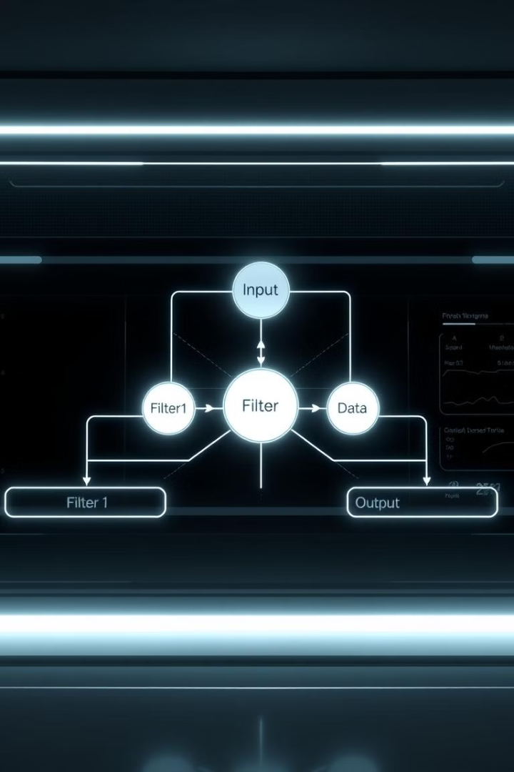



Proposed Methodology: Hybrid Approach
Content-Based Filtering
Uses TF-IDF for movie descriptions.
Collaborative Filtering
Employs user-based or item-based methods.
Hybrid Combination
Combines components using weighted averages.
A hybrid approach leverages both content and user data for enhanced recommendations.

Slide 5
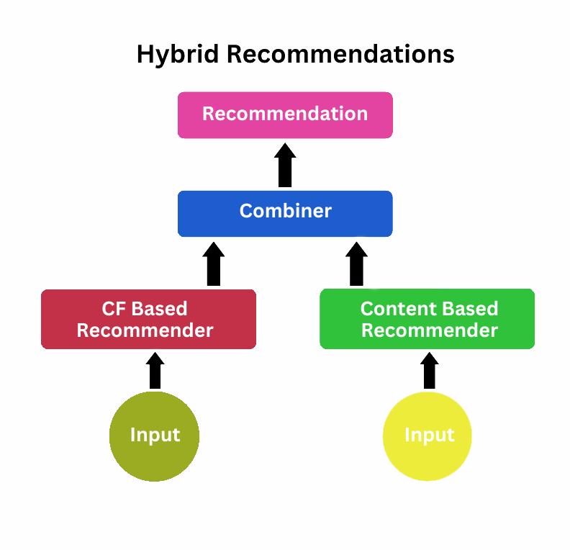
Code Snippets and Implementation
Content-Based Filtering
Collaborative Filtering
Calculates similarity scores from movie descriptions.
Predicts ratings based on user preferences.
Hybrid Integration
Combines scores for personalized recommendations.
Python, scikit-learn, and Pandas are used. Focus is on similarity scores and rating predictions.

Slide 6
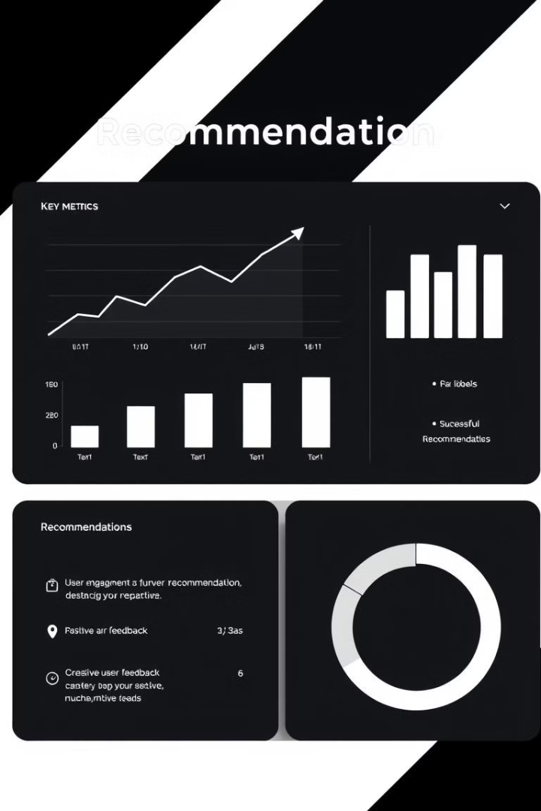



Results and Evaluation Metrics
Precision, Recall
MAE, RMSE
F1 Score
Metrics measure the accuracy and relevance. They include precision, recall, F1-score, MAE, RMSE, and NDCG.

Slide 7
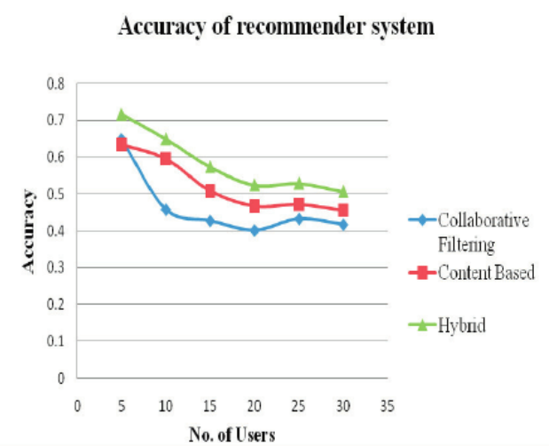
Comparison with Existing Systems
System
Precision
Recall
F1-score
Hybrid Model
0.85
0.78
0.81
Content-Based
0.75
0.68
0.71
Collaborative Filtering
0.80
0.72
0.76
The proposed system outperforms existing systems. Results show improvements in precision, recall, and F1-score.

Slide 8

Conclusion and Future Work
Cold Start
User Demographics
Address the cold start problem.
Hybrid Combinations
Incorporate user demographics.
Explore different hybrid approaches.
The hybrid system enhances movie recommendations. Future work includes exploring new combinations, incorporating demographics, and deploying the system.

